Slide 1
Foundations of Cryptography Merkle-Damgård transform, hash-and-MAC, birthday attack, Feistel network
LiangFeng Zhang
zhanglf@shanghaitech.edu.cn

Slide 2


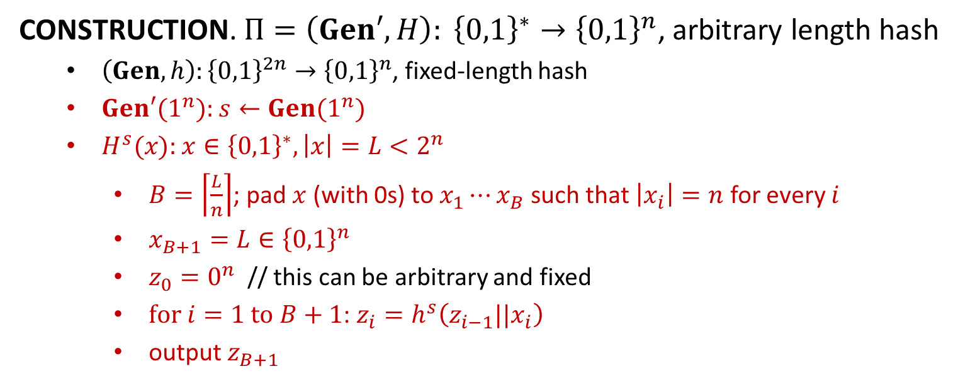












Merkle-Damgård Transform
$$x_{1}$$
$$x_{2}$$
$$⋯$$
$$x_{B}$$
$$x_{B+1}=L$$
$$z_{0}$$
$$h^{s}$$
$$h^{s}$$
$$⋯$$
$$h^{s}$$
$$h^{s}$$
$$H^{s}\left(x\right)=z_{B+1}$$
$$z_{1}$$
$$z_{2}$$
$$z_{B}$$
CONSTRUCTION. $Π=\left(Gen′, H\right): {\left\{0,1\right\}}^{∗}→{\left\{0,1\right\}}^{n}$, arbitrary length hash
$\left(Gen,h\right):{\left\{0,1\right\}}^{2n}→{\left\{0,1\right\}}^{n}$, fixed-length hash
$Gen′(1^{n}):$ $s←Gen(1^{n})$
$H^{s}(x):$ $x∈{\left\{0,1\right\}}^{∗}, \left|x\right|=L<2^{n}$
$B=\left\lceil \frac{L}{n}\right\rceil$; pad $x$ (with 0s) to $x_{1}⋯x_{B}$ such that $\left|x_{i}\right|=n$ for every $i$
$x_{B+1}=L∈{\left\{0,1\right\}}^{n}$
$z_{0}=0^{n}$ // this can be arbitrary and fixed
$for i=1 to B+1$: $z_{i}=h^{s}\left(z_{i−1}||x_{i}\right)$
output $z_{B+1}$
Examples: MD5; SHA family

Slide 3
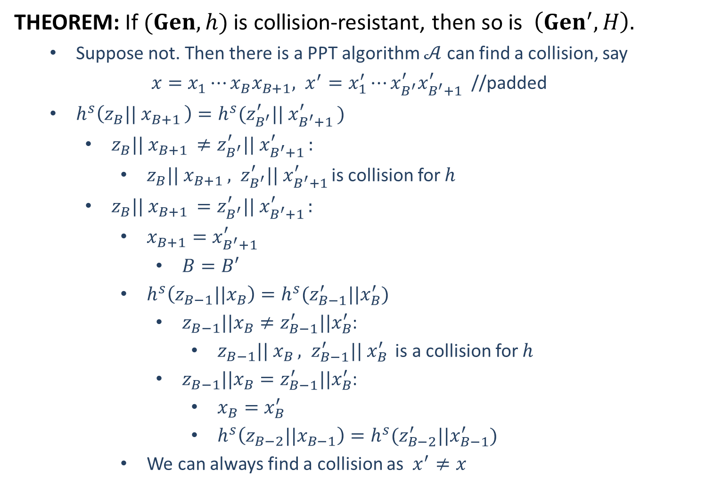
THEOREM: If $(Gen,h)$ is collision-resistant, then so is $\left(Gen^{′}, H\right).$
Suppose not. Then there is a PPT algorithm $𝒜$ can find a collision, say
$x=x_{1}⋯x_{B}x_{B+1}, x^{′}=x_{1}^{′}⋯x_{B^{′}}^{′}x_{B^{′}+1}^{′}$ //padded
$h^{s}\left(z_{B}|| x_{B+1 }\right)=h^{s}(z_{B^{′}}^{′}|| x_{B^{′}+1 }^{′})$
$z_{B}|| x_{B+1 }≠z_{B^{′}}^{′}|| x_{B^{′}+1 }^{′}:$
$z_{B}|| x_{B+1 }, z_{B^{′}}^{′}|| x_{B^{′}+1 }^{′}$is collision for $h$
$z_{B}|| x_{B+1 }=z_{B^{′}}^{′}|| x_{B^{′}+1 }^{′}$:
$x_{B+1}=x_{B^{′}+1}^{′}$
$B=B′$
$h^{s}\left(z_{B−1}||x_{B}\right)=h^{s}(z_{B−1}^{′}||x_{B}^{′})$
$z_{B−1}||x_{B}≠z_{B−1}^{′}||x_{B}^{′}$:
$z_{B−1}|| x_{B }, z_{B−1}^{′}|| x_{B }^{′}$ is a collision for $h$
$z_{B−1}||x_{B}=z_{B−1}^{′}||x_{B}^{′}$:
$x_{B}=x_{B}^{′}$
$h^{s}\left(z_{B−2}||x_{B−1}\right)=h^{s}(z_{B−2}^{′}||x_{B−1}^{′})$
We can always find a collision as $x^{′}≠x$

Slide 5
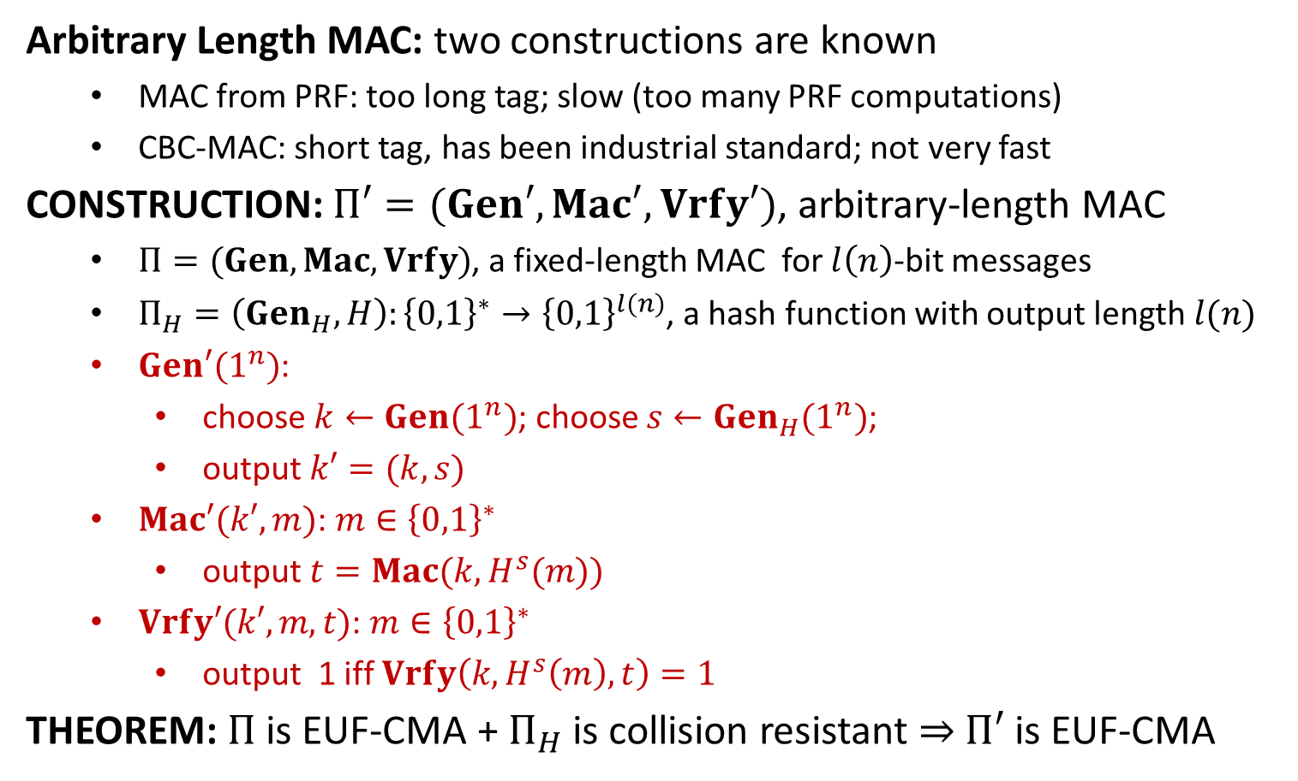
Hash-and-MAC
Arbitrary Length MAC: two constructions are known
MAC from PRF: too long tag; slow (too many PRF computations)
CBC-MAC: short tag, has been industrial standard; not very fast
CONSTRUCTION: $Π′=(Gen′,Mac′, Vrfy′)$, arbitrary-length MAC
$Π=(Gen, Mac, Vrfy)$, a fixed-length MAC for $l\left(n\right)$-bit messages
$Π_{H}=\left(Gen_{H}, H\right):{\left\{0,1\right\}}^{∗}→{\left\{0,1\right\}}^{l(n)}$, a hash function with output length $l(n)$
$Gen′(1^{n})$:
choose $k←Gen(1^{n})$; choose $s←Gen_{H}(1^{n})$;
output $k′=(k,s)$
$Mac′(k′,m)$: $m∈{\left\{0,1\right\}}^{∗}$
output $t=Mac(k, H^{s}(m))$
$Vrfy′(k′,m,t)$: $m∈{\left\{0,1\right\}}^{∗}$
output 1 iff $Vrfy\left(k,H^{s}\left(m\right),t\right)=1$
THEOREM: $Π$ is EUF-CMA + $Π_{H}$ is collision resistant $⇒$ $Π′$ is EUF-CMA

Slide 6




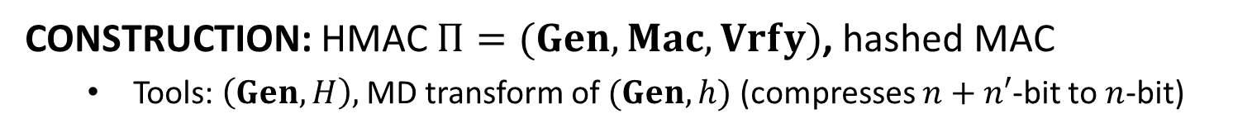












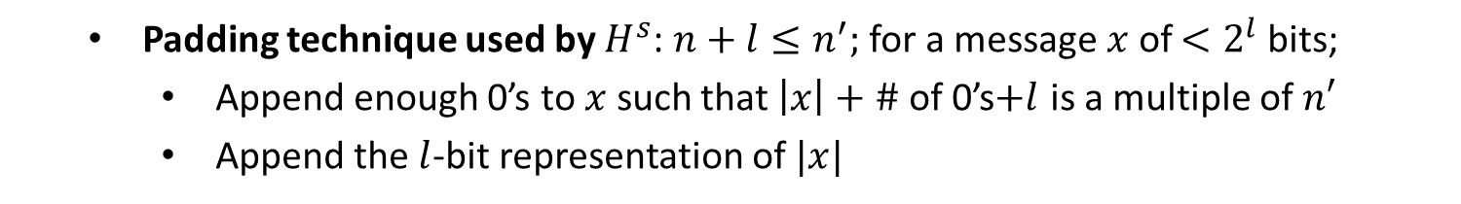






HMAC
CONSTRUCTION: HMAC $Π=(Gen, Mac, Vrfy)$, hashed MAC
Tools: $\left(Gen, H\right),$ MD transform of $(Gen, h)$ (compresses $n+n′$-bit to $n$-bit)
$$k⊕ipad$$
$$x_{1}$$
$$⋯$$
$$x_{d}$$
$${y=H}^{s}((k⊕ipad)||m)$$
$$IV$$
$$h^{s}$$
$$h^{s}$$
$$⋯$$
$$h^{s}$$
$$k_{in}$$
$$y^{′}=y||0⋯0||⋯$$
$$k⊕opad$$
$$h^{s}$$
$$h^{s}$$
$$t$$
$$IV$$
$$k_{out}$$
$$h^{s}(IV||k⊕opad)$$
REMARK: Industry standard, Highly efficient (Faster than CBC-MAC) ,
Easy to implement, Proof of security
Padding technique used by $H^{s}$: $n+l≤n^{′};$ for a message $x$ of $<2^{l}$ bits;
Append enough 0’s to $x$ such that $\left|x\right|+\#$ of 0’s$+l$ is a multiple of $n′$
Append the $l$-bit representation of $|x|$
$$x$$
$$0⋯0$$
$$|x|$$

Slide 8
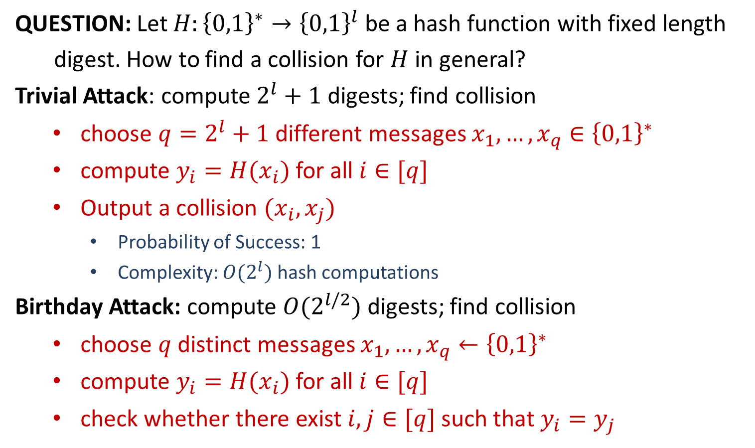
Attacks of Hash Functions
QUESTION: Let $H:{\left\{0,1\right\}}^{∗}→{\left\{0,1\right\}}^{l}$ be a hash function with fixed length
digest. How to find a collision for $H$ in general?
Trivial Attack: compute $2^{l}+1$ digests; find collision
choose $q=2^{l}+1$ different messages $x_{1},…,x_{q}∈{\left\{0,1\right\}}^{∗}$
compute $y_{i}=H(x_{i})$ for all $i∈[q]$
Output a collision $(x_{i},x_{j})$
Probability of Success: 1
Complexity: $O(2^{l})$ hash computations
Birthday Attack: compute $O(2^{l/2})$ digests; find collision
choose $q$ distinct messages $x_{1},…,x_{q}←{\left\{0,1\right\}}^{∗}$
compute $y_{i}=H(x_{i})$ for all $i∈[q]$
check whether there exist $i,j∈[q]$ such that $y_{i}=y_{j}$

Slide 9
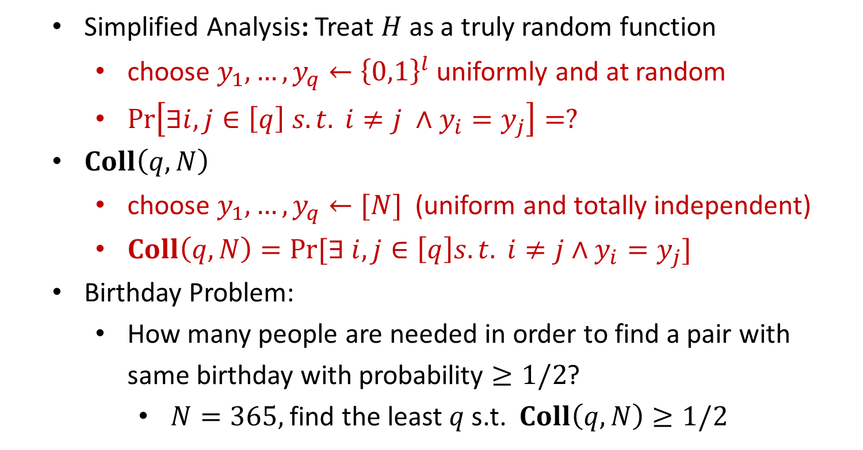
Attacks of Hash Functions
Simplified Analysis: Treat $H$ as a truly random function
choose $y_{1},…,y_{q}←{\left\{0,1\right\}}^{l}$ uniformly and at random
$\operatorname{Pr}\left[∃i,j∈\left[q\right] s.t. i≠j ∧y_{i}=y_{j}\right]=?$
$Coll\left(q,N\right)$
choose $y_{1},…,y_{q}←[N]$ (uniform and totally independent)
$Coll\left(q,N\right)=Pr⁡[∃ i,j∈\left[q\right]s.t. i≠j∧y_{i}=y_{j}]$
Birthday Problem:
How many people are needed in order to find a pair with same birthday with probability $≥1/2$?
$N=365,$find the least $q$ s.t. $Coll\left(q,N\right)≥1/2$

Slide 10
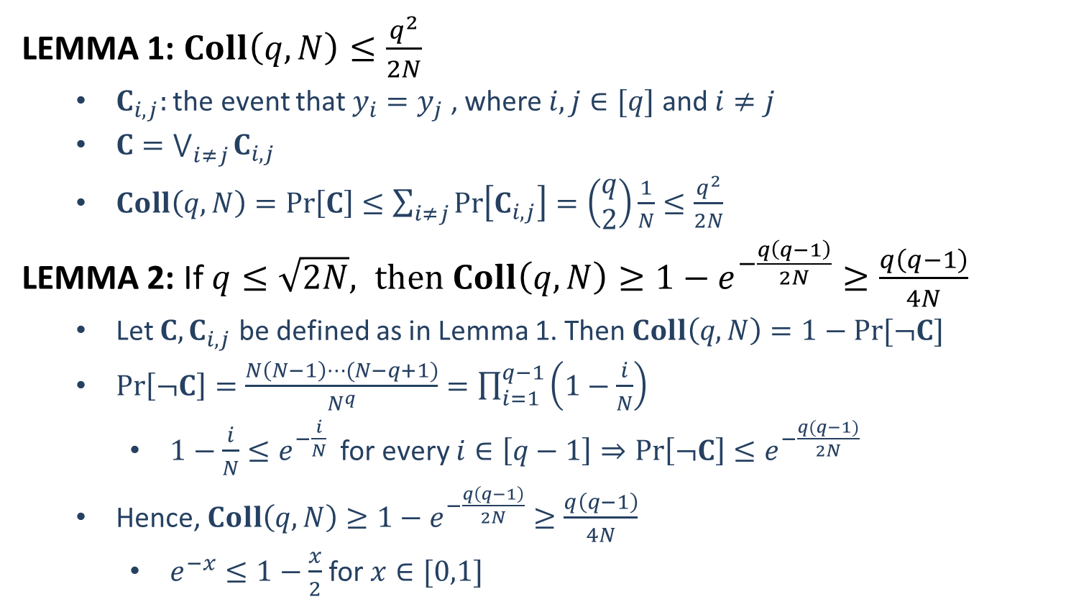
Attacks of Hash Functions
LEMMA 1: $Coll\left(q,N\right)≤\frac{q^{2}}{2N}$
$C_{i,j}:$ the event that $y_{i}=y_{j}$ , where $i,j∈[q]$ and $i≠j$
$C=\bigvee_{i≠j}{C_{i,j}}$
$Coll\left(q,N\right)=\operatorname{Pr}\left[C\right]≤\sum_{i≠j}{\operatorname{Pr}\left[C_{i,j}\right]}=\left(\begin{aligned}q \\ 2\end{aligned}\right)\frac{1}{N}≤\frac{q^{2}}{2N}$
LEMMA 2: If $q≤\sqrt{2N}, then Coll\left(q,N\right)≥1−e^{−\frac{q\left(q−1\right)}{2N}}≥\frac{q\left(q−1\right)}{4N}$
Let $C, C_{i,j}$ be defined as in Lemma 1. Then $Coll\left(q,N\right)=1−Pr⁡[¬C]$
$\operatorname{Pr}\left[¬C\right]=\frac{N\left(N−1\right)⋯(N−q+1)}{N^{q}}=\prod_{i=1}^{q−1}{\left(1−\frac{i}{N}\right)}$
$1−\frac{i}{N}≤e^{−\frac{i}{N}}$ for every $i∈\left[q−1\right]⇒\operatorname{Pr}\left[¬C\right]≤e^{−\frac{q(q−1)}{2N}}$
Hence, $Coll\left(q,N\right)≥1−e^{−\frac{q\left(q−1\right)}{2N}}≥\frac{q\left(q−1\right)}{4N}$
$e^{−x}≤1−\frac{x}{2}$ for $x∈[0,1]$

Slide 11
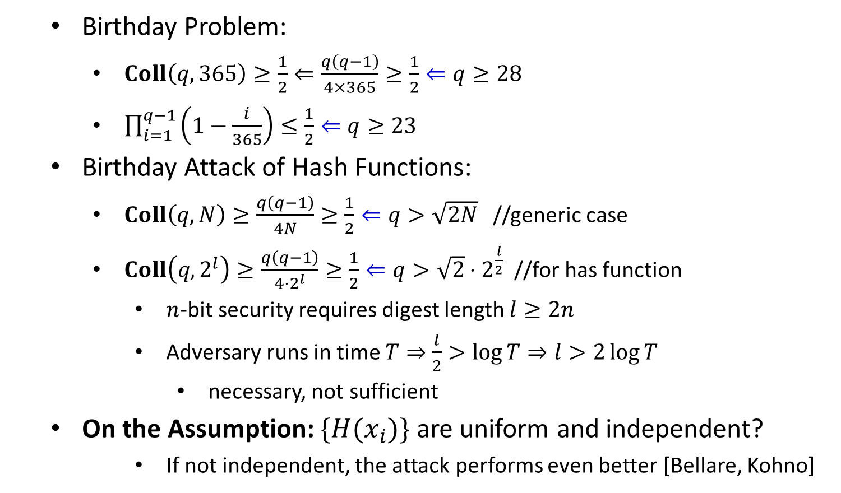
Attacks of Hash Functions
Birthday Problem:
$Coll\left(q,365\right)≥\frac{1}{2}⇐\frac{q\left(q−1\right)}{4×365}≥\frac{1}{2}⇐q≥28$
$\prod_{i=1}^{q−1}{\left(1−\frac{i}{365}\right)}≤\frac{1}{2}⇐q≥23$
Birthday Attack of Hash Functions:
$Coll\left(q,N\right)≥\frac{q\left(q−1\right)}{4N}≥\frac{1}{2}⇐q>\sqrt{2N}$ //generic case
$Coll\left(q,2^{l}\right)≥\frac{q\left(q−1\right)}{4⋅2^{l}}≥\frac{1}{2}⇐q>\sqrt{2}⋅2^{\frac{l}{2}}$ //for has function
$n$-bit security requires digest length $l≥2n$
Adversary runs in time $T⇒$ $\frac{l}{2}>\log{T}⇒l>2\log{T}$
necessary, not sufficient
On the Assumption: $\{H(x_{i})\}$ are uniform and independent?
If not independent, the attack performs even better [Bellare, Kohno]

Slide 13
Practical Constructions
Stream Ciphers:
LFSR (linear feedback shift register);
NFSR (nonlinear feedback shift register);
Combination Generator
Trivium, RC4
Block Ciphers:
Confusion-Diffusion Paradigm
Substitution-Permutation Network
AES (Advanced Encryption Standard)
Feistel Network
DES (Data Encryption Standard)
Hash Functions:
Davies–Meyer Construction
MD5 (Message Digest 5)
SHA (Secure Hash Algorithm)

Slide 14
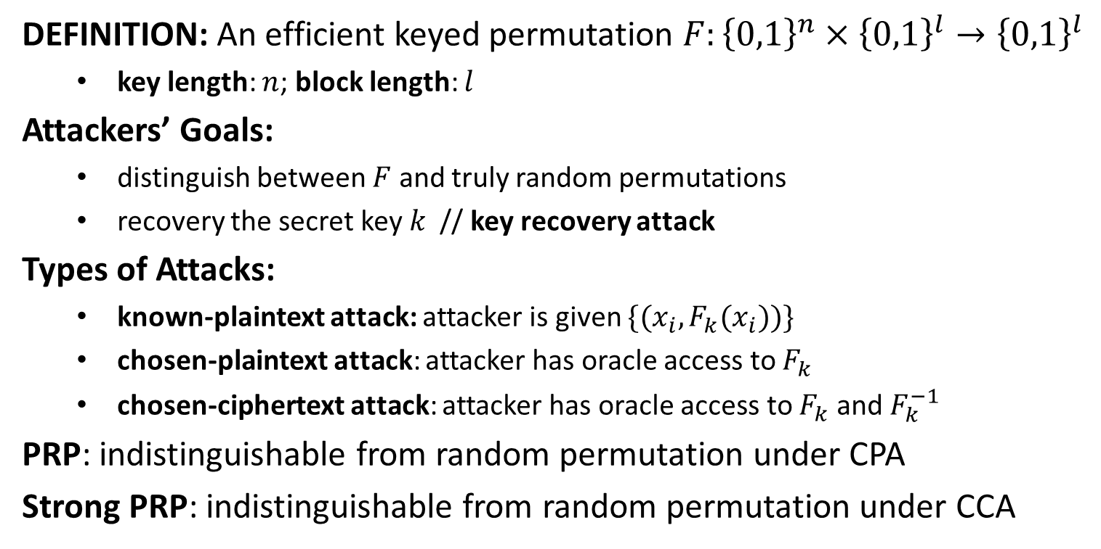
Block Ciphers
DEFINITION: An efficient keyed permutation $F:{\left\{0,1\right\}}^{n}×{\left\{0,1\right\}}^{l}→{\left\{0,1\right\}}^{l}$
key length: $n$; block length: $l$
Attackers’ Goals:
distinguish between $F$ and truly random permutations
recovery the secret key $k$ // key recovery attack
Types of Attacks:
known-plaintext attack: attacker is given $\{(x_{i}, F_{k}(x_{i}))\}$
chosen-plaintext attack: attacker has oracle access to $F_{k}$
chosen-ciphertext attack: attacker has oracle access to $F_{k}$ and $F_{k}^{−1}$
PRP: indistinguishable from random permutation under CPA
Strong PRP: indistinguishable from random permutation under CCA

Slide 15


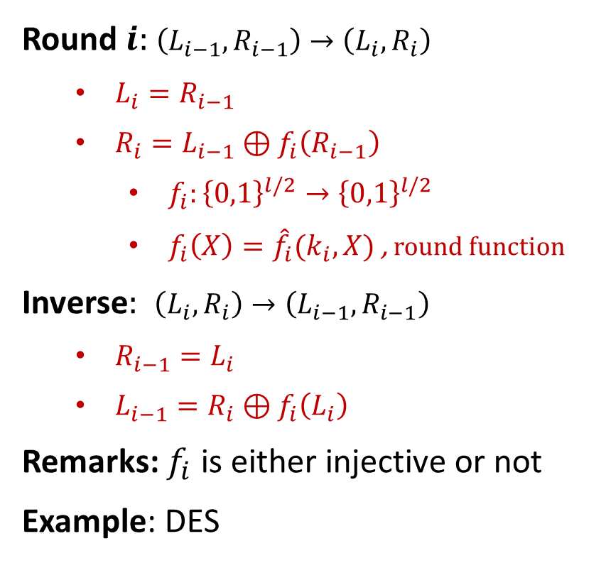









Feistel Network
$$L_{0}$$
$$R_{0}$$
Round $i:$ $\left(L_{i−1},R_{i−1}\right)→\left(L_{i},R_{i}\right)$
$L_{i}=R_{i−1}$
$R_{i}=L_{i−1}⊕f_{i}\left(R_{i−1}\right)$
$f_{i}:{\left\{0,1\right\}}^{l/2}→{\left\{0,1\right\}}^{l/2}$
$f_{i}\left(X\right)={\hat{f}}_{i}(k_{i},X)$ , round function
Inverse$:$ $\left(L_{i},R_{i}\right)→\left(L_{i−1},R_{i−1}\right)$
$R_{i−1}=L_{i}$
$L_{i−1}=R_{i}⊕f_{i}\left(L_{i}\right)$
Remarks: $f_{i}$ is either injective or not
Example: DES
$$f_{1}$$
$$L_{1}$$
$$R_{1}$$
$$f_{2}$$
$$L_{2}$$
$$R_{2}$$
$$f_{3}$$
$$L_{3}$$
$$R_{3}$$

Slide 16
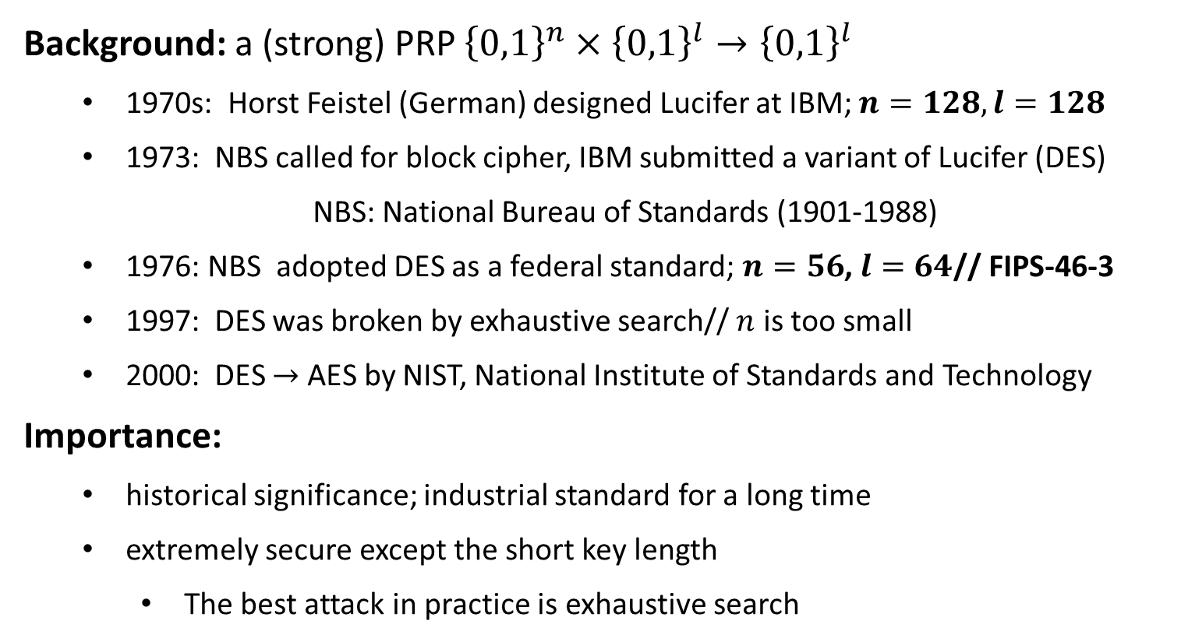
Data Encryption Standard (DES)
Background: a (strong) PRP ${\left\{0,1\right\}}^{n}×{\left\{0,1\right\}}^{l}→{\left\{0,1\right\}}^{l}$
1970s: Horst Feistel (German) designed Lucifer at IBM; $n=128, l=128$
1973: NBS called for block cipher, IBM submitted a variant of Lucifer (DES)
NBS: National Bureau of Standards (1901-1988)
1976: NBS adopted DES as a federal standard; $n=56$, $l=64$// FIPS-46-3
1997: DES was broken by exhaustive search// $n$ is too small
2000: DES $→$ AES by NIST, National Institute of Standards and Technology
Importance:
historical significance; industrial standard for a long time
extremely secure except the short key length
The best attack in practice is exhaustive search

Slide 17





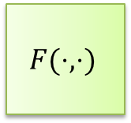












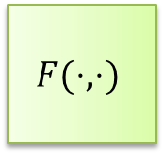


DES Encryption
$56$-bit
secret key $k$
key schedule
$48$-bit
$$k1$$
$$k2$$
$$⋯$$
$$k16$$
$$F(⋅,⋅)$$
$$F(⋅,⋅)$$
$$F(⋅,⋅)$$
$$m$$
$$IP$$
$$⋯$$
$$SW$$
$$IP^{−1}$$
$$c$$
$$L_{0},R_{0}$$
$$L_{1},R_{1}$$
$$L_{2},R_{2}$$
$$L_{16},R_{16}$$
$64$-bit
$64$-bit

Slide 18
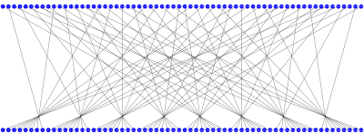
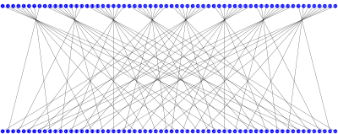
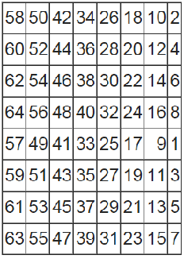
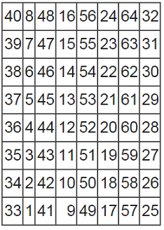





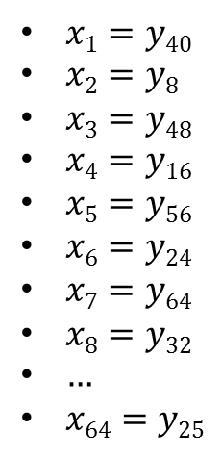
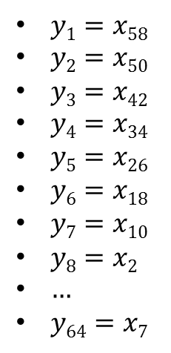

Initial Permutation IP
$$x=x1x2x3⋯x64$$
$$y=y1y2y3⋯y64$$
$$y=y1y2y3⋯y64$$
$$x=x1x2x3⋯x64$$
$$IP$$
$IP^{−1}$
$y1=x58$
$y2=x50$
$y3=x42$
$y4=x34$
$y5=x26$
$y6=x18$
$y7=x10$
$y8=x2$
$…$
$y64=x7$
$x1=y40$
$x2=y8$
$x3=y48$
$x4=y16$
$x5=y56$
$x6=y24$
$x7=y64$
$x8=y32$
$…$
$x64=y25$

Slide 19
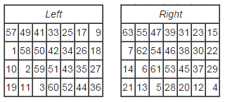
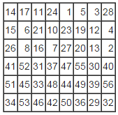















Key Schedule
64-bit key $K$
$$PC1$$
PC1
28-bit
28-bit
<
<
28-bit
28-bit
PC2
48-bit $k1$
<
<
28-bit
28-bit
PC2
48-bit $k2$
64-bit $K→$ 56-bit $k$
<<
<<
$$PC2$$
28-bit
28-bit
PC2
48-bit $k3$
$$⋮$$
$$⋮$$
<
<
28-bit
28-bit
PC2
48-bit $k9$
<<
<<
28-bit
28-bit
PC2
48-bit $k10$
$$⋮$$
$$⋮$$
<
<
56-bit$→$48-bit
28-bit
28-bit
PC2
48-bit $k16$

